Slide 1
Writing a Discussion Year 7 Science

Slide 2
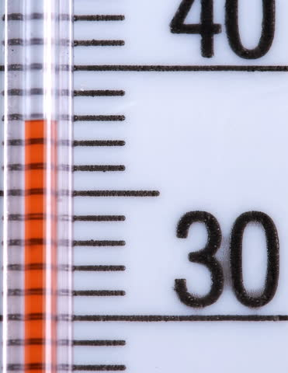
Learning Objectives
CFU
How many parts is our discussion going to have?
Write a three part discussion for an experiment
Write a conclusion for an experiment
Activate Prior Knowledge
Think, pair share: How do you read a measuring cylinder, thermometer or beaker?

Slide 3
Concept Development
CFU 1
Why do scientists need to analyse their experiments?
Scientists need to analyse their experiments, to make sure they are fair and reliable.
Scientists write a discussion to explain their analysis.
CFU 2
Tell the person next to you one thing a discussion must include.
A discussion in a science report includes:
Looking back at the hypothesis
Identifying errors that affect the reliability of the experiment
Identifying improvements that can be made to the experiment
CFU 3
What is an error?
Vocabulary
Error: an inconsistency in measurement

Slide 4
Concept Development
CFU 1
Tell the person next to you two things the first paragraph includes.
CFU 2
Tell the person next to you if the hypothesis was supported or not. How do you know?
Paragraph 1: Looking back at the hypothesis
State whether the hypothesis was supported or not
Explain your choice using examples from your data
Time (min) | Tin Temperature (°C) | Copper Temperature (°C)
0 | 25 | 25
2 | 35 | 30
4 | 47 | 36
6 | 57 | 42
8 | 65 | 50
10 | 72 | 55
A student had the hypothesis
Copper heats at a faster rate than tin
His paragraph might be
The hypothesis was not supported by the results. After 10 minutes of heating, the copper only reached a temperature of 55°C but the tin reached 72°C. This shows that tin heats faster than copper.
Try writing a paragraph for your experiment.
Vocabulary
Error: an inconsistency in measurement

Slide 5
Concept Development
CFU 1
Tell the person next to you two things the second paragraph includes.
CFU 2
Tell the person next to you how this error might affect the results of this experiment.
Paragraph 2: Identifying errors
Identify an error that would affect the reliability of the results
Explain how the errors would affect the results
The error the student identified is
The copper was heated with a yellow flame for part of the experiment.
His paragraph might be
A source of error in this experiment was that the copper was not heated with a blue flame for the entire experiment. This means that the copper wasn’t getting the same amount of heat as the tin. This could have affected the results because the heating of the copper was not consistent and may have been lower than it should have been.
Try writing a paragraph for your experiment.
Vocabulary
Error: an inconsistency in measurement

Slide 6
Concept Development
CFU 1
Tell the person next to you two things the second paragraph includes.
CFU 2
Tell the person next to you how this might improve the reliability of the experiment.
Paragraph 3: Identifying improvements
Identify a way to improve the reliability of the results
Explain how the reliability would be improved
The improvement the student identified is
The metals could be heated in an oven or on a hot plate
His paragraph might be
An improvement that would make this experiment more reliable is to heat the metals in an oven or on a hot plate. This would make the results more reliable because the metals can be heated at the same time and would receive the same amount of heat.
Try writing a paragraph for your experiment.

Slide 7
Concept Development
CFU 1
Tell the person next to you what the conclusion is.
Conclusion: Summing up the experiment
A brief statement describing what was found out in the experiment
The student’s conclusion might be:
This experiment showed that different metals heat at different rates. The piece of tin heated faster than the copper. The experiment can be made more reliable by using a different heat source, so both metals receive the same amount of heat
Try writing a conclusion for your experiment.

